Slide 1
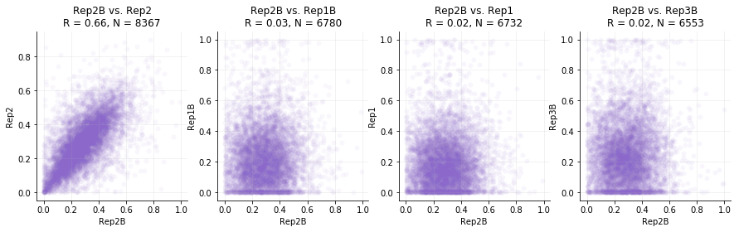
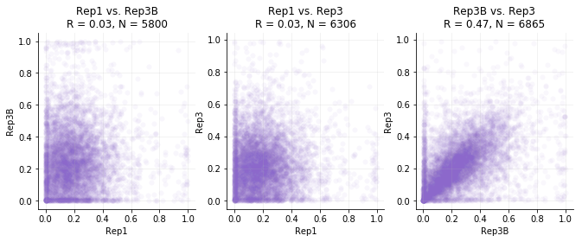
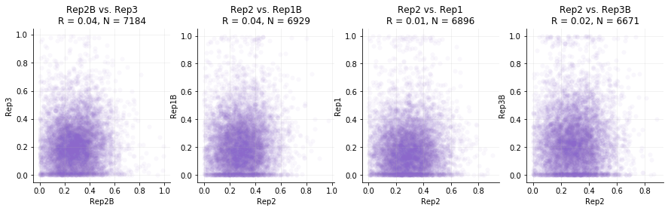
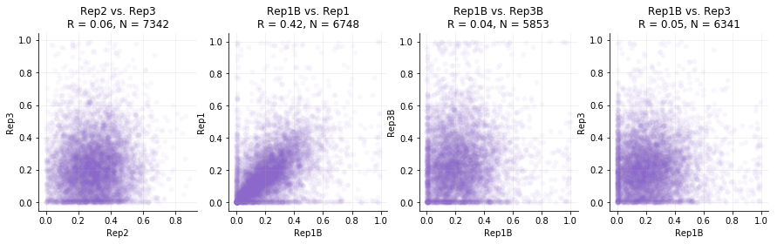
Replicate consistency: prime edit
Plot depicts pairwise scatterplots of prime editing frequency between all pairs of conditions: unedited, rep1-3 and rep1b-3b.
Peptides with fewer than 100 total reads were filtered. Calculated frequencies include wild-type outcomes.
Observations
- Gray boxes: RepN and RepNb have notable consistency. R = 0.42 to 0.66
Between non-replicates, Pearson correlation is near zero.

